Slide 1
HINDALCO INDUSTRIES BILLET TRACKING USING RFID

Slide 2
CUSTOMER REQUIREMENTS
CUSTOMER REQUIRED PORTABLE READERS FOR CHECK THE STOCKS AND MATERIAL MOVEMENT WITH WIFI CONNECTIVITY
CUSTOMER REQUIRED CHEPEST TAG WITH LAMINATION FOR REUSING
TAG ATTACHMENT USING LOOP TAG
AN APPLICATION REQUIRED TO TRACK AND CROSS CHECK THE STOCK

Slide 3
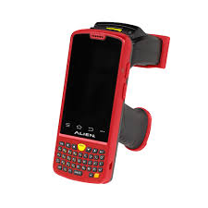
PROCESS FLOW
USING ALIEN
PORTABLE READER
SCAN IT BASED ON
THE MOVEMENT OF ITEM WITH HELP OF APPLICATION SOFTWARE
RFID 9640 INLAY TAG WITH LAMINATION
FIXED INTO EACH PACKED BILLET USING LOOP TAG

Slide 4
CHALLENGES
PRODUCTS ARE MADE UP OF METAL
BILLET STACKED WITH BULKLY IT WILL AFFECT THE READING
DATA TRANSFER THROUGH WIFI NETWORK

Slide 5
ADVANTAGES
REDUCE THE MANPOWER
ITEM BASED TRACKING
FASTEST PHYSICAL VERIFIACTION
READING DISTANCE UPTO 3 MTRS

Slide 6
THANKS
PRESENTER NAME:PRAMOD C
CUSTOMER NAME:HINDALCO INDUSTRIES

